Slide 1
Fractal Analysis
Wanjun Gu
031020

Slide 2


Slide 3
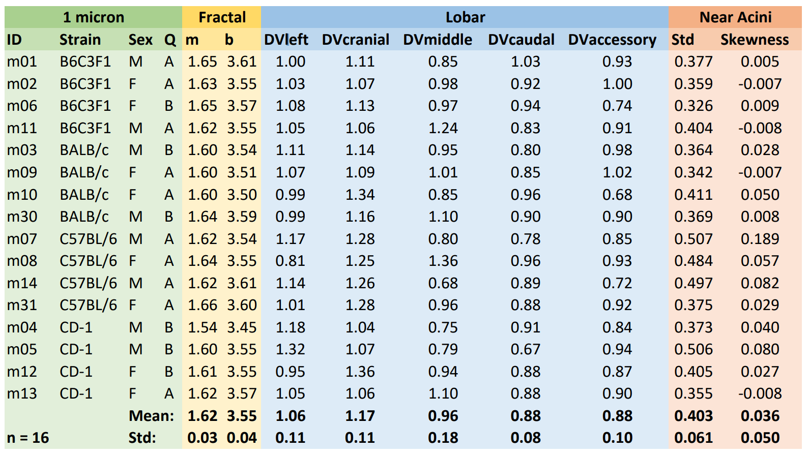

Slide 4
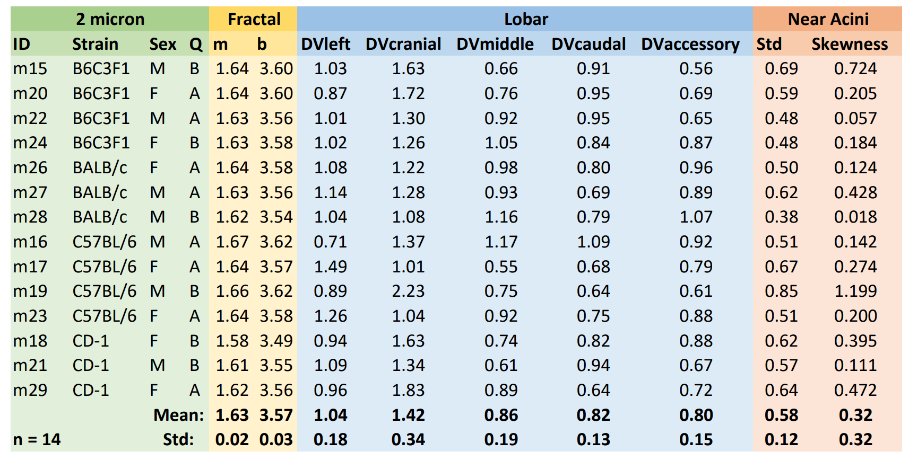

Slide 5



Slide 6



Slide 7



